Slide 1
Researchie – A research agent
CAPSTONE PROJECT
Presented By:
Rahul Rawat , Lamrin Tech Skills University Punjab, CSE

Slide 2
OUTLINE
Problem Statement
Proposed System/Solution
System Development Approach
Algorithm & Deployment
Result (Output Image)
Conclusion
Future Scope
References

Slide 3
Problem Statement
In the age of information overload, researchers, students, and professionals often struggle to extract key insights from lengthy and complex documents. Traditional manual reading is time-consuming, inefficient, and prone to oversight, especially when dealing with multiple research papers or technical documents.

Slide 4
Proposed Solution
To solve this problem, we present Researchie, an AI-powered agent developed using IBM Watsonx.ai on IBM Cloud.
It accepts textual queries or documents and returns accurate, AI-generated summaries—enhancing the speed and efficiency of research tasks.
Hosted on IBM Cloud, ensuring fast processing and scalability for large documents or multiple users.
Can be adapted with domain-specific prompts to summarize research papers, business reports, medical documents, etc.

Slide 5
System Approach
Platform Used:
IBM Cloud
IBM Watsonx.ai
Prompt-based interaction within the cloud interface
Functionality Implemented:
Created a cloud-based agent using IBM Watsonx
Uses Granite model.
Configured with summarization instructions
Interacts with uploaded text or typed input to generate concise results

Slide 6
Algorithm & Deployment
Model Used:
IBM Watsonx.ai Granite Large Language Model
Development Steps:
Configured and tested summaries using the Watsonx model interface
Used textual input fields directly within Watsonx to evaluate summarization capability.
Deployment:
Entirely built and tested in the IBM Cloud environment
Summarization happens within Watsonx’s inbuilt model evaluation interface

Slide 7
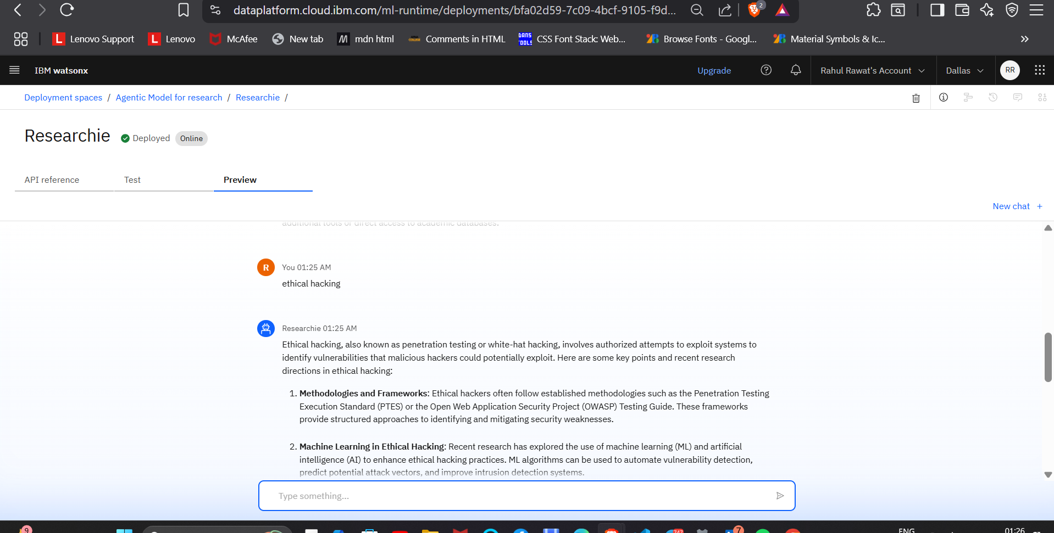
Result

Slide 8
Conclusion
The AI agent provides fast and high-quality summarization
Demonstrates how cloud platforms like IBM Watsonx can be leveraged for intelligent research assistance
No external infrastructure or backend needed for basic implementation

Slide 9
Future scope
Integrate with a web-based UI in future (e.g., chat interface)
Add document upload features for PDF summarization
Include citations, keywords, and multi-language support
Extend to voice-based research agents

Slide 10
References
Ibm Skillbuild Tutorials.
Edunet Foundation sessions during internship
IBM Watsonx.ai Documentation
https://www.ibm.com/products/watsonx-ai
https://cloud.ibm.com/docs/watsonx-ai
https://www.ibm.com/blog/ibm-watsonx-granite-models-explained

Slide 11
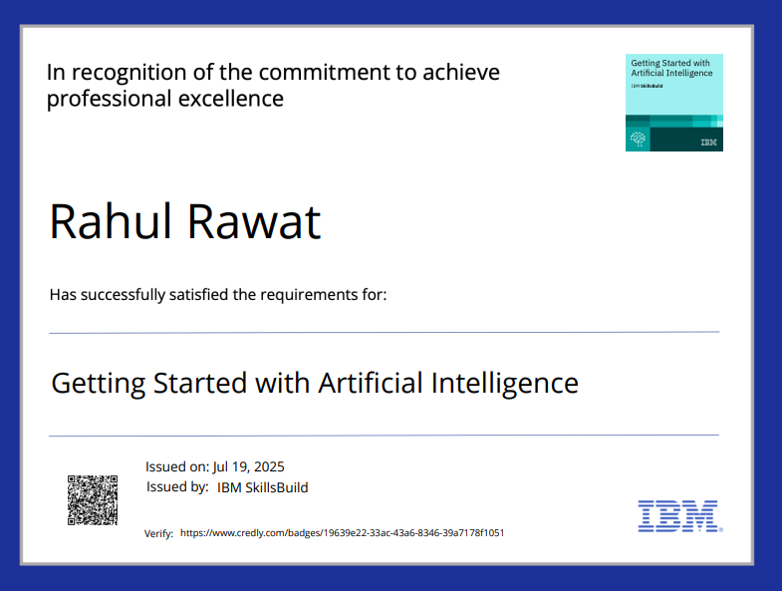
IBM Certifications

Slide 12
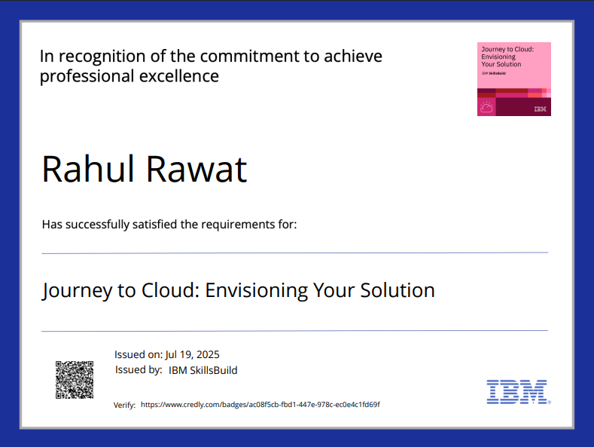
IBM Certifications

Slide 13
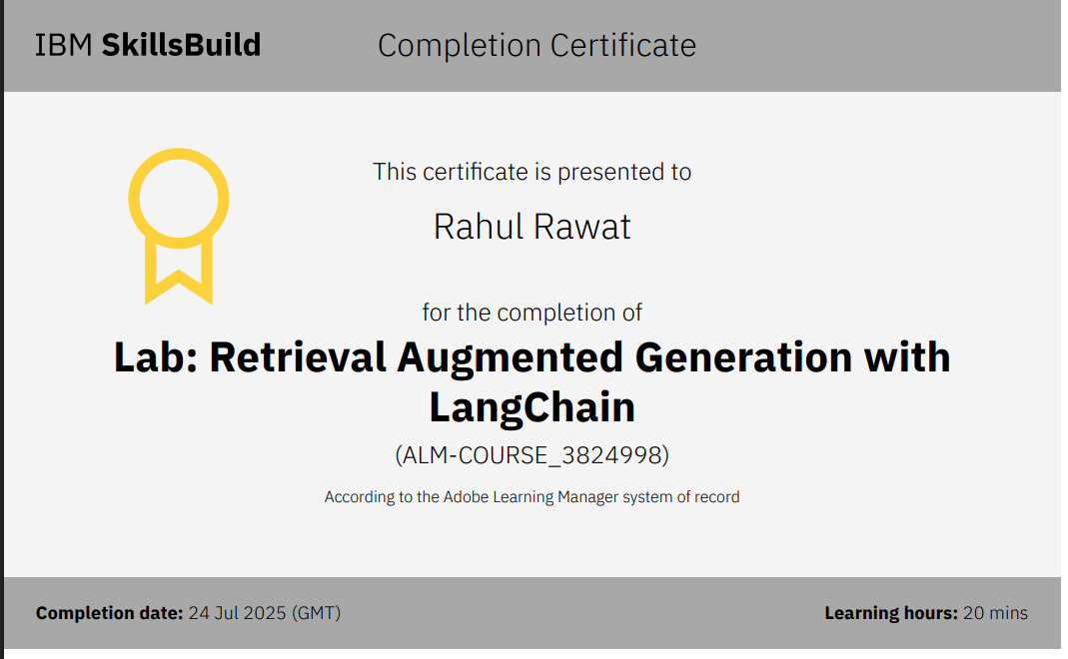
IBM Certifications

Slide 14
THANK YOU

